Slide 1

GM Foundational Economy Innovation Fund – Round 2
Information Event for Prospective Applicants
15th April 2025
Beth Sharratt (she/her), Local Industrial Strategy Policy and Programmes Lead

Slide 2
Purpose of today’s event:
  To help you to Understand what we mean by the ‘foundational economy’, and why we want to support it
  Provide an overview of the Foundational Economy Innovation Fund and the kind of projects we’re looking to fund
  To help you to decide whether the fund is a good opportunity for you
  Give you a chance to ask questions
  Please refer to the ‘quick guide’ or full ‘guidance for applicants’ for more detail
Notes:
Thanks for coming
Introduce myself
Housekeeping – please submit your questions through the Q&A
We’ll be sharing a recording (without attendee details) and a write up of the questions after the event
If we don’t get to your question/s, it will be answered later as part of the write-up
If you think of a question after this event you can email us
We will share the slides

Slide 3














What is the the Foundational Economy?
The "foundational economy" is a way of conceptualising or grouping a number off sectors of the economy that supply essential goods and services, used by everyone in everyday life
It includes a place’s key workers, essential supply chains and infrastructure, culturally important goods and services (like hairdressing and beauty) and underpins places, other parts of the economy and well-being.
Health and Social Care
Early Years and Childcare
Education
Retail
Construction
Transport
Hospitality, Leisure and Tourism
Utilities and Infrastructure
Agriculture and Fishing
Manufacturing (foundation sectors)
Public Administration
Housing
Financial, Insurance and Real Estate Services
Communications
Notes:
It’s a concept – a way of describing a bunch of stuff
Also known as the everyday economy
It’s large and is operating by a huge range of businesses and organisations across sectors

Slide 4
What is the Foundational Economy?
The "foundational economy" is a way of conceptualising or grouping a number off sectors of the economy that supply essential goods and services, used by everyone in everyday life
It includes a place’s key workers, essential supply chains and infrastructure, culturally important goods and services (like hairdressing and beauty) and underpins places, other parts of the economy and well-being.
Health and Social Care
Early Years and Childcare
Education
Retail
Construction
Transport
Hospitality, Leisure and Tourism
Utilities and Infrastructure
Agriculture and Fishing
Manufacturing (foundation sectors)
Public Administration
Housing
Financial, Insurance and Real Estate Services
Communications
Notes:
We have decided to focus on a few different parts of the foundational economy through this programme – I will explain this shortly

Slide 5
Why a Challenge Fund?
We know that the foundational economy an be overlooked by traditional approaches to economic development, which tend to focus on high-growth sectors
GM’s foundational economy is huge – with an estimate 60,000 businesses and employing approximately 42% of the workforce. Addressing the challenges faced by this sector is critical to creating inclusive economic growth
Jobs in the foundational economy are likely to be lower paid and less secure that in other parts of the economy and improving pay and conditions in FE sectors is challenging. Some progress is being made via the Real Living Wage Campaign and Good Employment Charter to address these challenges – we want to build the capacity of the sector to address challenge such as these in innovative ways
The Foundational Economy is also being hit simultaneously by the cost of living and cost of doing business crisis, and the potential for ongoing shocks points to the need for innovation rather than short-term solutions.
The Foundational Economy has fewer innovation networks – we want to build innovation capacity and a community of innovators to go after bigger investment or opportunities in the future.
Notes:
Too big to ignore! Have to address if we want to create inclusive economic growth

Slide 6
Fund Overview – Two Stages of Funding
Testing Phase
This is what we’re focusing on today – this will see up to 25 projects will receive up to £11,000 to test out innovative ideas
Scale up Phase
The 25 projects funded as part of the ‘Testing’ phase will be invited to apply for further funding to scale up their project – 15-20 will receive further funding of up to £60,000
Notes:
This is Round 2 of the fund
Some of you may have submitted an expression of interest in February or March this year. This was an opportunity to get some feedback on a potential project, but doesn’t influence the application process. If you didn’t submit an expression of interest you are welcome to apply.

Slide 7
Ineligible Activities
Subsidising standard industry training or wellbeing support
Subsidising business as usual activity including the hiring of new staff to do existing roles or functions to expand the size of an organisation
Subsidising consumer prices or providing vouchers
Advertising or the promotion of existing products and services
Providing bonuses, finical incentives or sponsorship monies for staff
Upgrading tills, EOPS systems, booking systems or other business ICT which is already commonly used in the sector
The purchase of readily available energy efficiency solutions (e.g., solar panels, insulation, or ground source heat pumps) on the marketplace unless it can be justified that the use of this would be innovative or contribute to further development and learning regarding this solution
Upgrading, expanding, or adding new physical structures to your premises, or purchasing a new premises, unless this activity is one aspect of an innovation to address one of the challenges
Projects that were funded through Round 1 of the Fund (unless proposing a new innovation that builds on your learning)
Notes:
We don’t want anyone to waste their time on an application unnecessarily, so I’m going through these first!
This fund isn’t about providing a cash injection or subsidising the cost of established ways to expand or improve your business
Is it readily available and widely used in your industry? If ‘yes’ it’s probably not innovative
Not sure? Ask

Slide 8
Eligibility
Eligible Sectors – you must be working in or proposing to support one or more of these sectors:
Health & Social Care
Early Years and Childcare – 0-5 years
The Local High Street (retail, hospitality, leisure, tourism, personal services, culture)
Your proposed project must address one or more of the ‘challenge areas’ or ‘sector-specific’ challenges
The fund is open to Private, Voluntary, Community, Faith and Social Enterprise (VCFSE) and Public sector organisations, as long as the proposed projects are based in Greater Manchester
Notes:
We’re casting the net wide – we want to capture creative ideas that address the challenges identified

Slide 9
Challenge Areas (1/2) – Same as 1st Round
Supporting the Workforce - Innovations that help with developing, recruiting and retaining staff. This could include new ways of upskilling the workforce, improving progression routes or providing greater flexibility of working patterns and security of hours worked. This could also include finding new ways to connect employers and potential employees, including the self-employed and those who have struggled to find stable work, particularly individuals experiencing inequalities. This does not include using funds to subsidise staff to conduct business as usual activity, the use of monetary incentives, or the purchasing of wellbeing services. ​
More Effective Services and Products - Innovations that help create or integrate new ways of delivering your current services or products to a higher standard by doing things more efficiently and effectively. This could include re-thinking your approach to resourcing, organising work, and the adoption or development of technology. This is not about expanding or fundamentally changing the services or products you provide, but instead doing what you do already, better. ​
Localising Supply Chains, Low Carbon and Net Zero - Innovations that support local, sustainable, and circular supply chains. Circular supply chains being those that share, lease, reuse, repair, refurbish, and recycle existing materials and products for as long as possible within Greater Manchester. Innovations that reduce or manage energy consumption and carbon emissions, including via the development and testing of new technology, as well as new systems and initiatives to use and share resources more efficiently or reduce the use of resources. ​
Notes:
Please don’t try to make a project that does not address a challenge fit. It might be a brilliant idea, but it’s just not right for this fund!
These broad challenge areas were identified when developing Round 1 of the fund following extensive stakeholder engagement

Slide 10
Challenge Areas (2/2)
New for Round 2 – Sector-Specific Challenges
The specific challenges for the Health and Social Care sector are:
Innovations that could support the role of technology and digital solutions in enabling care, including supporting people through the utilisation of technology
Innovations that could keep people well in the community - reducing demand on primary, secondary and specialist care​
The specific challenges for the Early Education and Childcare sector are:
Innovations that could increase the supply of early education places in areas where a need has been identified
Innovations that could contribute to developing the pipeline of level 3 qualified staff in the early education and childcare workforce
The specific challenges for The Local High Street sector are:
Innovations that could increase recycling rates in food-based hospitality
Innovations that could improve capacity for financial management
Innovations that could support better utilisation of underused buildings or facilities
Notes:
For Round 2 we’re adding to the broad challenge areas with some sector-specific challenges

Slide 11
Identifying your challenge area
When applying, you should identify the ‘challenge area’ or ‘sector-specific challenge’ that your project primarily aims to address. Here are a couple of examples:
Scenario 1: You run an upcycling business, refurbishing and selling furniture, and you want to innovate your recruitment to build a pathway for disabled people to join your workforce.
Your sector is the Local High Street
Your challenge area is ‘Supporting the Workforce’
Scenario 2: You are a tech company with an idea for a digital product that would enable health and social care providers to support their clients within their home
Your sector is Health and Social Care
Your sector-specific challenge is ‘Innovations that could support the role of technology and digital solutions in enabling care, including supporting people through the utilisation of technology’
Notes:
For the purpose of the application, please try to identify the challenge area or sector-specific challenge your project is mainly seeking to address
It may not be that clear cut, that’s OK. You can select more than one
If it doesn’t address a challenge, it’s not the right idea for this fund!

Slide 12
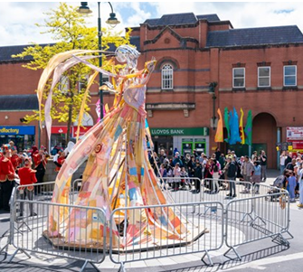
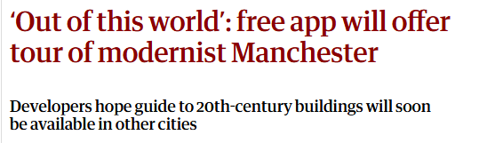

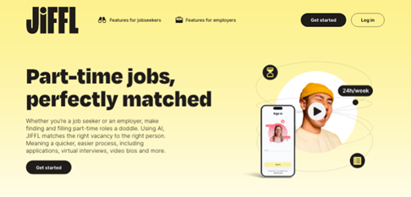
Round 1- Highlights (1/2)
Manchester Modernist Society – New Tours app supported by FEIF covered by the Guardian
Cabasa’s network of volunteer growers produced non-synthetic fabric dyes for groundbreaking ‘Living Dress installations
Green Street Pioneers has launched ‘Borro’ - a reusable cup scheme in the Northern Quarter and Ancoats areas of Manchester – reducing waste and saving hospitality businesses money on single use items
Launch of JiFFL – a platform specifically designed for the part-time and flexible job market
Notes:
Some individual project highlights – they give you flavour of what we are looking for
Information of all of the projects funded through Round 1 can be found in the yearbook on the webpage

Slide 13

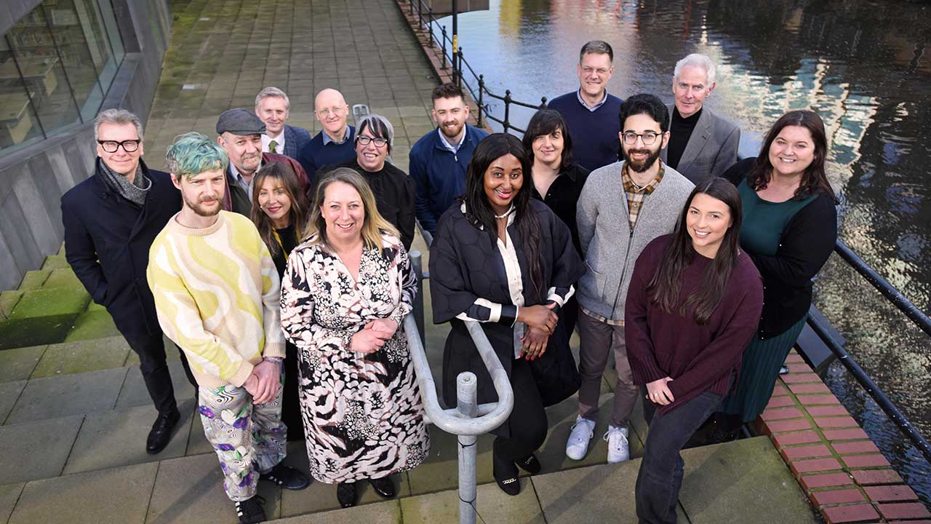
Round 1- Highlights (continued)
The Foundational Economy Innovation Fund was nominated for the Most Innovative Project at the Institute for Economic Development Awards 2024
Business Insider published their piece ‘Boosting the Foundational Economy’ in March 2025
Business Insider held a Roundtable event with projects from Round 1 who had been successful in securing Scale Up funding
Notes:
Some Programme-Wide recognition
Unfortunately we lost out to Cheshire’s business tapas! However it was great exposure
Glasgow is launching its own fund using the GM FEIF model

Slide 14
More than a fund
Alongside funding – projects will take part in:
A network that will connect you with other funded projects (including those funded during Round 1) and other stakeholders interesting in supporting the foundational economy
Tailored Business Support to help develop your project – this could include things such as specialist advice on commercialising your innovation
A Research and Evaluation Programme that will build an evidence base in what works in supporting the foundational economy
Notes:
Recognise that investment is important, but this fund is a drop in the ocean when you thinking about the scale of the FE!
we want funded projects to get so much more than financial support
Alongside building innovation capacity directly through the funded projects, we want to raise the profile of the sector and the challenges it faces
Networking and growing leadership and advocacy for the sector will also be an important part of Round 2

Slide 15
Application Checklist
Before submitting be sure to check you can answer ‘yes’ to the following questions
The proposed project:
Impacts on one of the eligible sectors
Addresses on of the challenges (either one of the main 3 challenge areas or one of the sector-specific challenges)
Would generate impact within Greater Manchester
Doesn’t include any ‘ineligible activity
If you are relying on a particular partner to deliver your project, you have secured their agreement in principle before applying
Is innovative
Is deliverable within the proposed funding (up to £11,000) and timescale (Approx July 2025 – March 2026)
Also that you have read the ‘guidance for applicants’ document in full

Slide 16
Finally - Remember these tips
Read the guidance document
Don’t try and shoehorn in an idea that doesn’t fit!
Make the most of the word count to tell us about your idea (not general info about your business/organisation) and how you would deliver your project
Avoid jargon
Be clear about how your project is innovative and different from your business as usual
Write down your answers on a separate document before copying and pasting into the Microsoft form
If you have any questions after today that aren’t answered by reading the guidance document, please email gmcaeconomy@greatermanchester-ca.gov.uk
Don’t leave applying to the last minute! The form will close at 23.59 on Tuesday 13th May
Notes:
The form will not be accessible after this time !
Good luck – we look forward to hearing your ideas

