Slide 1
Pension Credit and Winter Fuel Payments
Summary for Stockport
9 October 2024

Slide 2
Pension Credit summary
Stockport
(February 2024 data)
This part of the data pack can be used to help understand the local Pension Credit landscape and identify wards for targeted campaign work.

Slide 3
Pension Credit entitlements
Pension Credit is made up of two parts and some pensioners may be eligible for one or both parts:
1. Guaranteed Credit tops up incomes to a guaranteed minimum level, which in 2024/25 is £218.15 per week for single people and £332.95 for couples. When savings surpass £10,000 entitlement is reduced by £1 for every £500 in savings above that threshold.
Extra credit - some pensioners may get extra credit if any of the following also apply:
- they have a severe disability;
- they care for another adult;
- they are responsible for children or young people.
2. Savings Credit is available to those who retired before April 2016 and saved for retirement, for example through a personal or workplace pension. In 2024/25 this credit can be up to £17.01 for single people or £19.04 for a couple.
NB: New rule changes could be made and then come into force. For example, there are planned changes to Tax Credits in 2025 for those over state pension age.
Main Source: Pension Credit: What you'll get - GOV.UK (www.gov.uk)
Other sources used can be provided if needed.

Slide 4
Pension Credit - other potential benefits
Eligibility to Pension Credit can also unlock access to additional benefits which can, for some pensioners, add up to thousands of pounds worth of additional savings/benefits per year. They may include some or all of the following depending on individual circumstances:
Help with health costs
Free NHS dental treatment and help with the cost of glasses/contact lenses plus help with transport to hospital.
Carers on Pension Credit might get an extra amount known as Carer Addition, which is worth up to £45.60 a week.
If the pensioner on Pension Credit has a disability, then an extra amount known as Severe Disability Addition may be provided, which is worth up to £81.50 a week.
Help with housing costs
Deduction on Council Tax bill (rates can vary e.g. if other adults in the property).
Help with rent – possibly paid in full by Housing Benefit.
Help with paying mortgage interest payments and potentially help with ground rent and service charges.
Cost of living payments from DWP.
Other potential “passport” benefits (subject to criteria being met.)
A free colour TV licence for pensioners on Pension Credit AND who are aged 75 or more. In 2024 this could be a saving of £169.50.
Cold Weather Payment - currently £25.00 per week during particularly cold weather in winter months only.
  Warm Home Discount (scheme reopening in October 2024) £150 one-off discount on the electricity bill.
  Free insulation and energy-efficient improvements.
  Low-cost broadband and call charges from some providers – rates will vary.
  United Utilities ‘Help to Pay’ scheme for Pension Credit claimants which puts a cap on water bills with Tier 1 presently £282.
  Reduced cost for postal redirection.
Main source: Pension credit advice from Age UK
Other sources used can be provided if needed.

Slide 5
Key statistics for Stockport (February 2024)
Average weekly award amount of Pension Credit = £70.27 in February 2024 for all ages of pensioners.
(GM average = £75.60)
In February 2024, there were 5,657 Pension Credit claimants in Stockport out of 57,182 residents aged 66 or more (mid-2023), equating to 9.9% of all older residents.
It is estimated that around £7.6 million is currently being unclaimed in Stockport each year and that some 3,322 pensioners that are eligible are not claiming Pension Credit. (See Footnote 1.)
The estimated cost to the health and social care system due to non full uptake of Pension Credit in Stockport alone is approx. £25 million. (See Footnote 2.)
The (pre-2023) wards with the highest estimated number of non-claimants but entitled to Pension Credit (February 2024) in Stockport are:
  Brinnington and Central (338).
  Bredbury Green and Romiley (234).
  Davenport and Cale Green (209).
Footnote 1: The unclaimed amount is based on national data that suggests that 63% of the total number of people eligible to claim Pension Credit actually claim, and that nationally, actual Pension Credit expenditure represents 73% of the total sum that would be paid out if all eligible claimants received it.
Footnote 2: A new method was used to estimate the costs this time, but the starting point is still the GB cost of £4.876 bn taken from the Independent Age report from 2020. The local costs are based on the proportion of non-claimants locally relative to the total number of non-claimants across GB.
Sources: Stat-Xplore, Pension Credit, Tables 2 and 4 and ONS midyear population estimates.

Slide 6
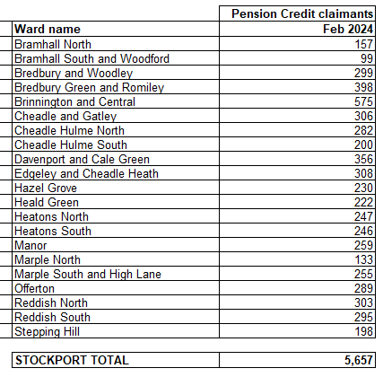
Pension Credit claimants by wards in Stockport (February 2024)
Note: the data was only available for the pre-2023 ward boundaries in GM.
Sources: Stat-Xplore website, Pension Credit table 1 (All four categories added.)

Slide 7
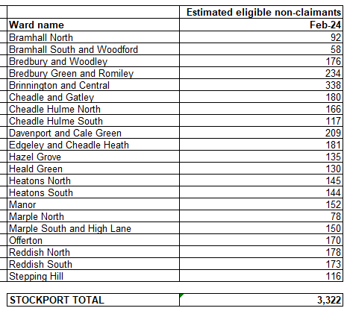
Estimated Eligible Non-Recipients (ENRs) by ward in Stockport (February 2024)
Note: the data was only available for the pre-2023 ward boundaries in GM.
Note: The estimates for not claiming/amount not claimed could go up or down despite awareness campaigns as there are a number of factors that can influence the number of claimants. These include for example migration, numbers becoming pensioners, death rates, changes in circumstances and rules etc.
Note: The estimates are based on the application
of a national take up rate to the local level.
Sources:
Stat-Xplore, Pension Credit tables
ONS midyear population estimates.
Income-related benefits: estimates of take-up: financial year ending 2022 - GOV.UK (www.gov.uk)

Slide 8
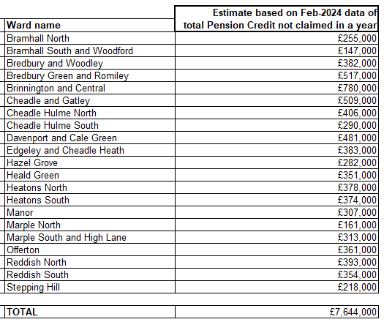
Estimated total amount of missed Pension Credit uptake in Stockport (February 2024)
Note: the data was only available for the pre-2023 ward boundaries in GM.
Note: The estimates are based on the application of national take up and expenditure rates to the local level.
Sources:
Stat-Xplore website, Pension Credit tables PC 4.
pension-credit-tables-FYE-2022.ods (live.com) (Estimated expenditure take-up in worksheet PC2 cell ref B82) data within the series Income-related benefits: estimates of take-up: financial year ending 2022

Slide 9
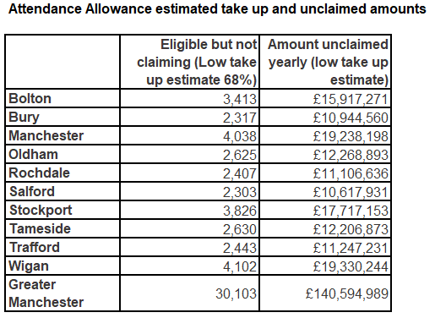
Attendance Allowance
Attendance Allowance helps with extra costs if you have a disability severe enough that you need someone to help look after you.
It’s paid at 2 different rates and how much you get depends on the level of care that you need because of your disability.
Individuals can get £72.65 or £108.55 a week to help with personal support if they’re both:
Physically or mentally disabled
State Pension age or older
(It does not cover mobility needs.)
People of pension age could get extra Pension Credit, Housing Benefit or Council Tax Reduction if they receive Attendance Allowance.
It is estimated that the amount of Attendance Allowance unclaimed in Greater Manchester is £140,594,989. Combined with unclaimed Pension Credit and Carers Allowance, the potential amount of unclaimed entitlement is here could be as much as £367 million.
Source: Attendance Allowance: The methodology for this comes from this report by Policy in Practice published in December 2023 Unclaimed-Attendance-Allowance_report-by-Policy-in-Practice-for-MSE_Dec23.pdf (policyinpractice.co.uk).

Slide 10
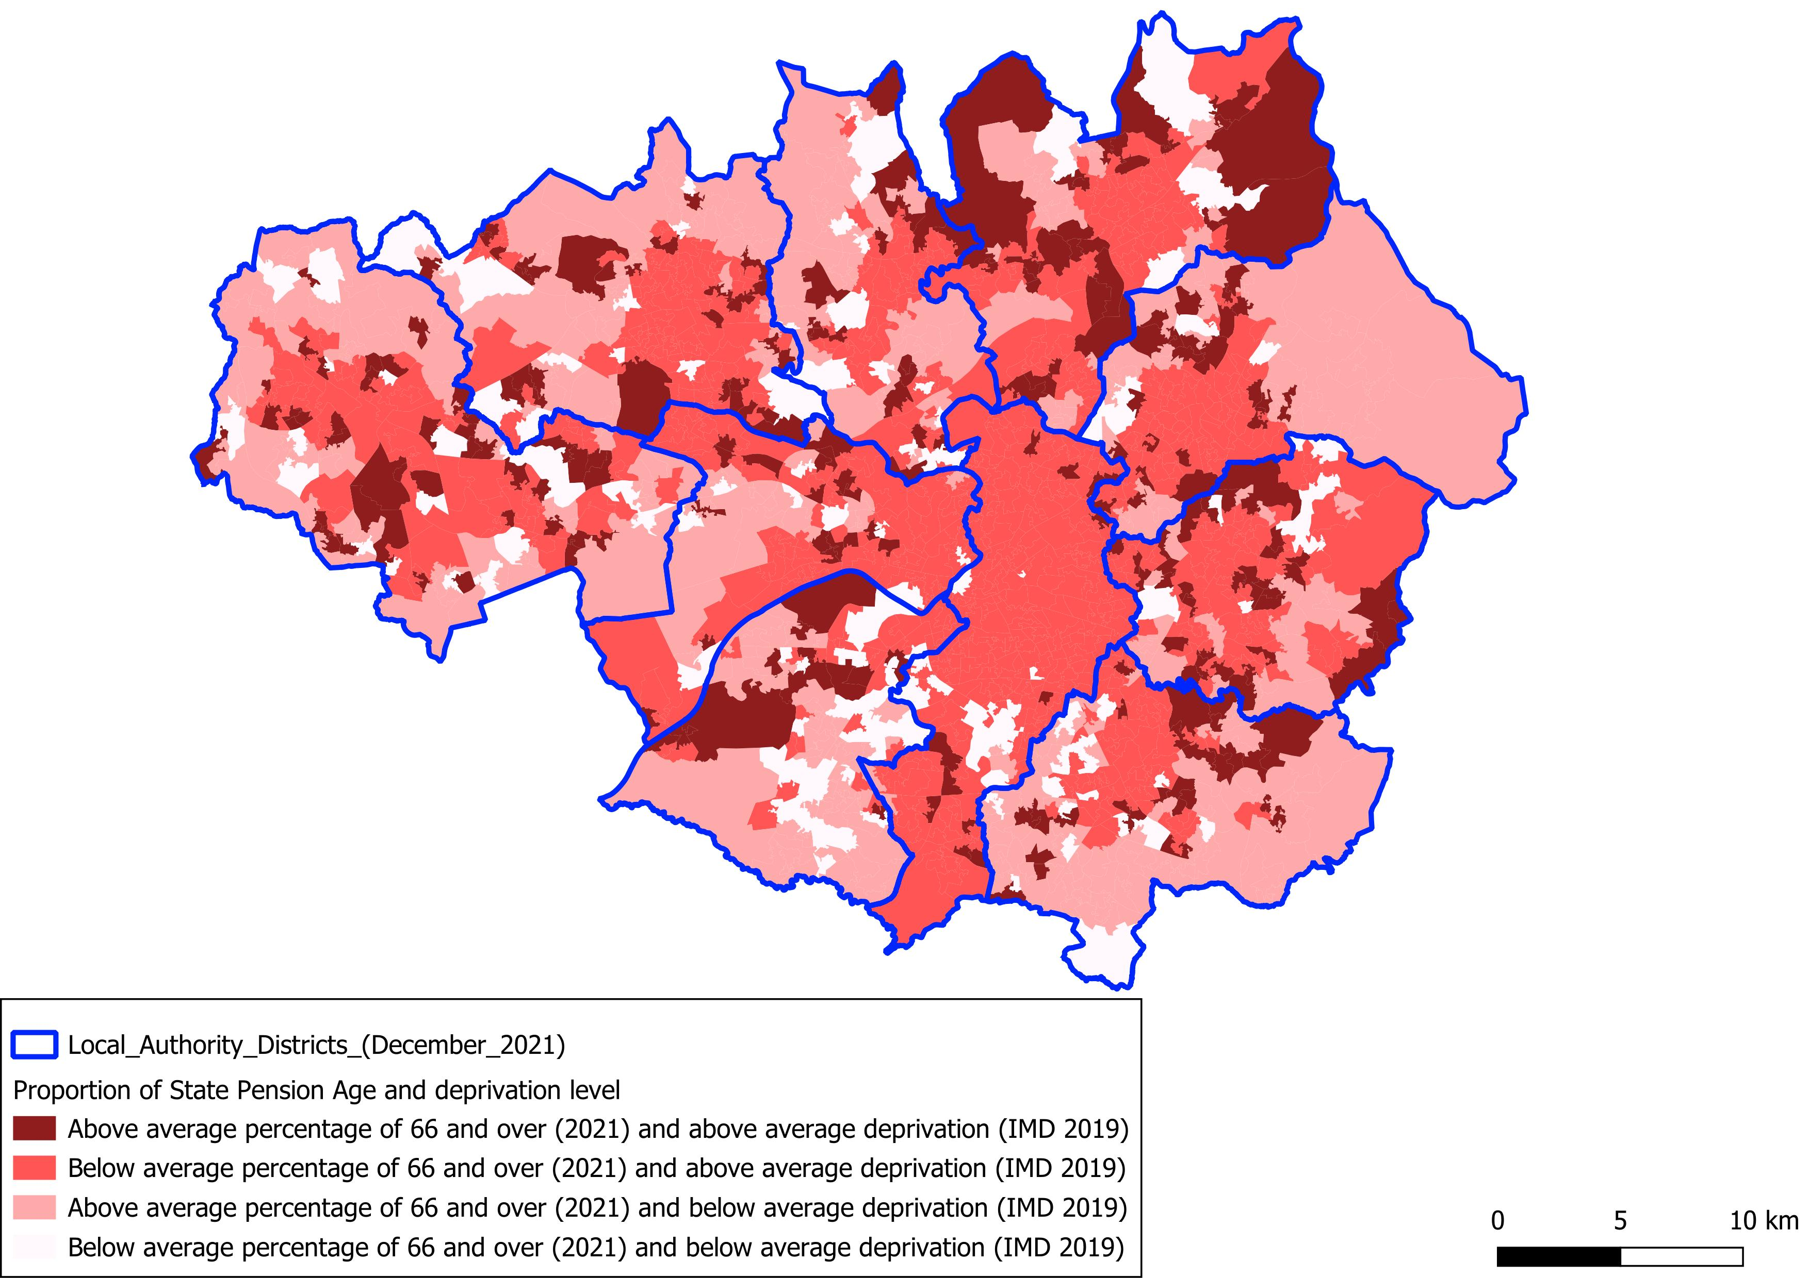
Areas of deprivation across GM by state pension age
The map shows the areas in GM where:
the percentage of the local population of state pension age in 2021 is either above or below the average for England.
- the deprivation level is in the top half nationally (more deprived deciles 1-5) or the lower half nationally (less deprived deciles 6-10) on the 2019 Index of Multiple Deprivation (IMD).
The darker red coloured areas have higher levels of deprivation and higher proportion of elderly residents.
The boundaries are Lower Layer Super Output Areas (LSOAs), which are smaller than wards.
2021-based population data is the latest available at LSOA level.
Sources: ONS, 2021 mid-year population estimates and 2019 Index of Deprivation.

Slide 11
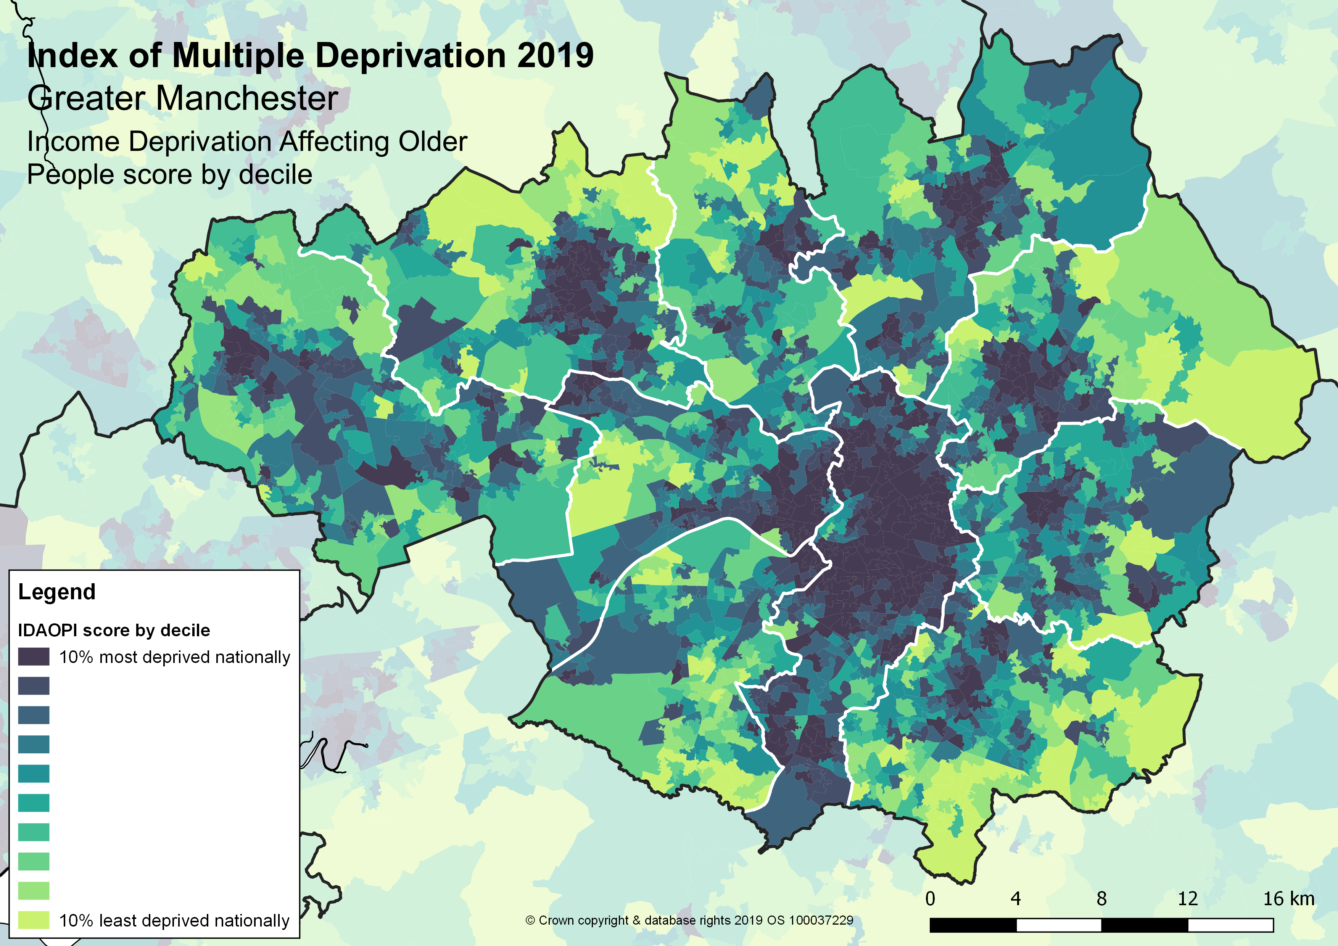
Income deprivation affecting older people
Source:
English Indices of Deprivation 2019
Using subdomain Income Deprivation Affecting Older People Index (IDAOPI)

Slide 12
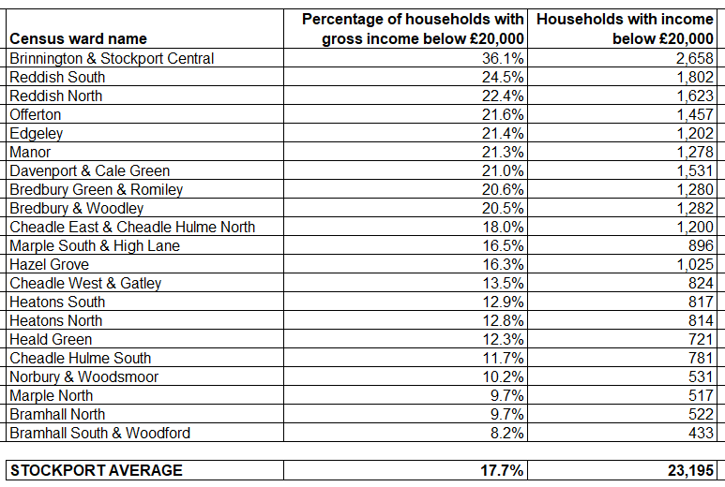
Wards with the highest proportion of low-income households
Note 1:
Data can be made available at different geographies if needed.
Note 2:
Ward names are at the time of the 2021 Census outputs and are the current wards.
Note 3:
There is no age breakdown in this dataset. A number of households will not contain pensioners. The listing is therefore just of all households with low income.
Note 4:
Household income is gross income.
Sources:
2024 annual release of CACI’s Paycheck data.

Slide 13
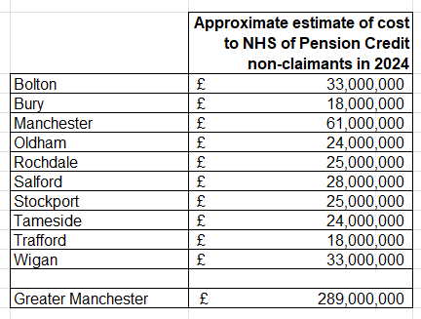
Potential savings to the NHS and social care services
As a high-level estimation, the NHS and other social care services could save some £25 million a year if every pensioner in Stockport entitled to Pension Credit but not currently claiming did claim their entitlement.
Note: Impact of changes in Winter Fuel Allowance are not factored into these calculations.
Source: The cost of pensioner poverty and non-take-up of Pension Credit | Independent Age
Estimates for GB from the above report were adjusted for inflation and then apportioned to GM districts based on the estimated number of Pension Credit non-claimants in that district as a proportion of the total number of non-claimants in GM as a whole. Estimates are a high-level approximation and should be treated with care.

Slide 14
Winter Fuel Allowance summary
(Winter 2024/25 estimates)

Slide 15
Changes in Winter Fuel Payment
In the summer of 2024, the Government announced changes to the Winter Fuel Payment (sometimes called Winter Fuel Allowance). From winter 2024/25, households in England and Wales will no longer be entitled to the Winter Fuel Payment unless they receive Pension Credit or certain other means-tested benefits. 10.8 million pensioners in England and Wales received the Winter Fuel Payment for winter 2023/2024. The Department for Work and Pensions (DWP) estimates that 1.5 million individuals in England and Wales will receive a payment for winter 2024/25 under the new rules, representing a reduction of 9.3 million claimants (down 86%).
This section looks at the impact of the changes in GM at the district level, based on the number of residents currently receiving Winter Fuel Payment (and the value of the payments they receive) and how this compares to the potential number (and value) from winter 2024/25 when eligibility will be restricted to people entitled to Pension Credit. Note that the predicted reductions in Winter Fuel Payment are based on current levels of Pension Credit uptake, so increased uptake of Pension Credit (for example, due to national publicity about the forthcoming change and/or local campaign activity) will reduce the impact, which might be overstated.
Not all older people entitled to Winter Fuel Payment receive the same amount. There are two levels of payment: either £200 or £300, with those aged 80 or more receiving the higher allowance. This has been factored into the estimates of change.
Note: we have drawn on the latest GM data on Pension Credit claimants, for February 2024, but the latest detailed data on Winter Fuel Payment is for 2022/23.

Slide 16
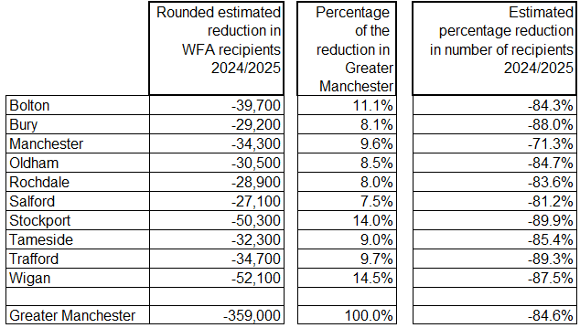
Winter Fuel Allowance (WFA) benefit – estimated reduction in recipients
Example: in Stockport there were 55,936 who received WFA in 2022/23, and this is expected to decrease to approximately the number who are claiming Pension Credit (latest figure is 5,657) so the reduction will be around -50,300 recipients since 2022/23. This is 14.0% of the total reduction across GM (-359,000) and a drop in recipients in Stockport since 2022/23 of -89.9%.
Sources: Stat-Xplore Pension Credit Table 3 and Winter Fuel Payment statistics for winter 2022 to 2023 - GOV.UK (www.gov.uk)

Slide 17
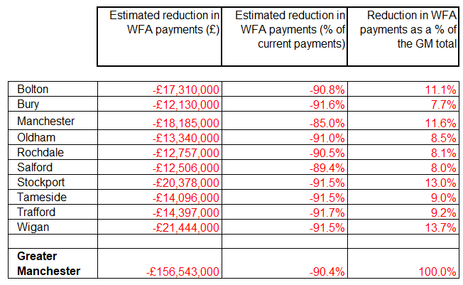
Winter Fuel Allowance (WFA) benefit – estimated reduction in payouts
Example: in Stockport total WFA payout in 2022/23 (the latest year for which there is data) was £22,264,400. Total payout in 2024/25 is estimated at £1,886,500 representing a reduction of some £20,378,000. This estimate is -91.5% lower than the payout in 2022/23. The reduction of £20,378,000 in Stockport is 13.0% of the total estimated reduction across GM.
Sources: Stat-Xplore Pension Credit Table 3 and Winter Fuel Payment statistics for winter 2022 to 2023 - GOV.UK (www.gov.uk)

Slide 18
Annex – key assumptions
Pension Credit – take-up rate (claimants)
The calculations on non-claimants of Pension Credit are based on the latest take-up rate – the percentage of those that could claim that actually do make a claim. However, at present this data is only available for Great Britain as a whole, so our calculations assume that the same rate applies across GM. The latest rate (2022 data) is 63%. The rate is updated annually in: Income-related benefits: estimates of take-up - GOV.UK (www.gov.uk)
Pension Credit – take-up rate (financial benefit)
The calculations on the amount of Pension Credit not claimed are based on the latest take-up rate for the financial benefit, i.e. of the total claimable resource, the proportion that is actually claimed. As above, the take-up date data is only available for Great Britain, and it is assumed that the same rate applies across GM. The latest rate (2022 data) is 73%. The rate is updated annually in: Income-related benefits: estimates of take-up - GOV.UK (www.gov.uk)
Cost to the NHS calculations
The calculations to the NHS due to non-claimants not receiving Pension Credit are based on a figure from the Independent Age report of 2020. Within the report, it is estimated that the extra health care cost due to Pension Credit non-claimants is £4.876 billion across Great Britain. No local estimates are available. Inflation has been applied to this figure, and the cost apportioned to GM districts based upon the proportion of GB non-claimants in each district. Source: Pension Credit Independent Age and Loughborough University report (independentage.org)
Winter Fuel Allowance (WFA) payment reductions
The calculations to estimate the reduction in the number due to receive WFA across GM in 2024/25 are based on assuming that only those on Pension Credit will receive WFA. The Pension Claimant figures from February 2024 were used in the calculations. A small number of people claiming certain other benefits (not including Pension Credit) will also be entitled to WFA, but these people are not included in the calculations. If Pension Credit take-up rates increase between February 2024 and winter 2024/25, when the new policy is due to be implemented, take-up of WFA will increase.

Slide 19
Contact details
Contact: Mike Doocey, GMCA
E-mail: mike.doocey@greatermanchester-ca.gov.uk
Mobile: 07973 876156

