Slide 1

Celebrating technical education achievements
and helping you make an informed decision about your next steps

Slide 2


GMACS
GMACS helps you plan your future and find your next steps after school.
It’s packed with inspiration, advice and tips to help you decide what’s right for you.
Discover local jobs, apprenticeships and courses all in one place.
Start building your career today at gmacs.co.uk

Slide 3


MBacc Gateways
Shaped with our top employers, the 7 MBacc gateways represent the growing and in demand sectors in GM.
Each gateway will guide you toward the relevant knowledge, skills and experience to lead you to high-quality jobs in these sectors.
The gateways are:

Slide 4
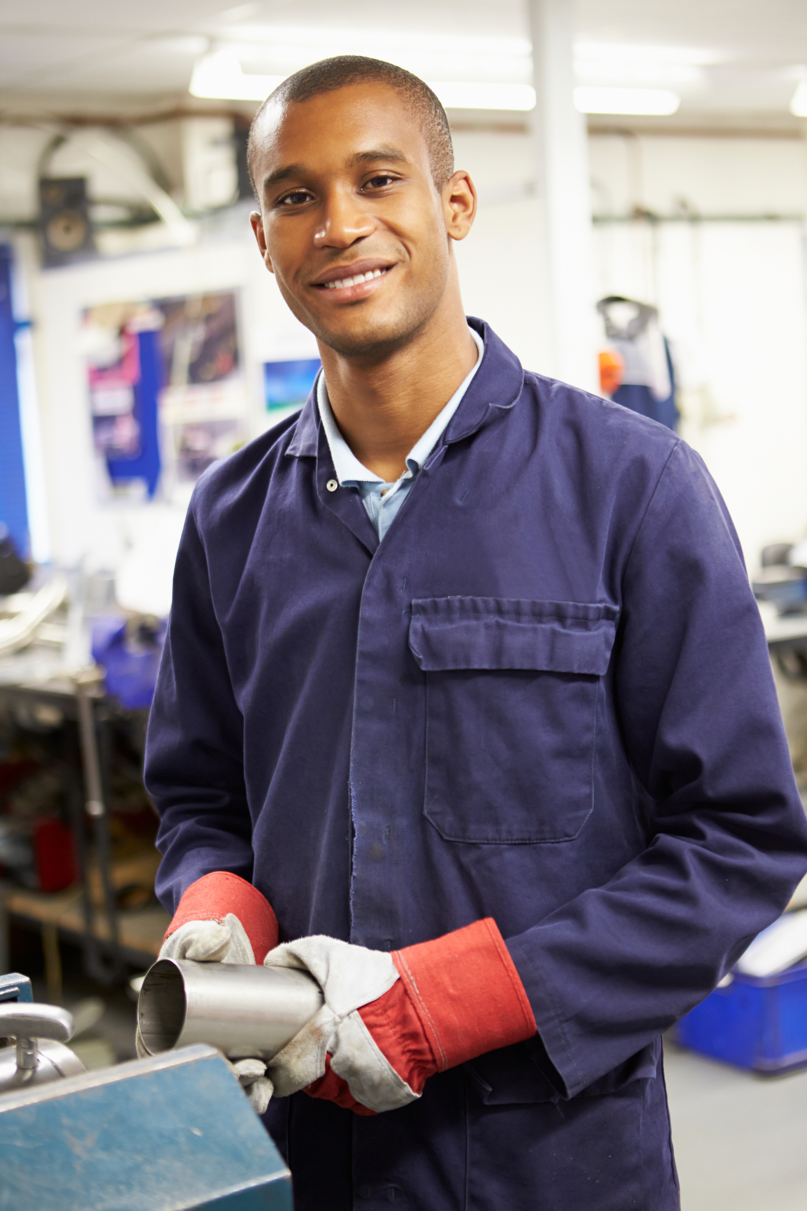
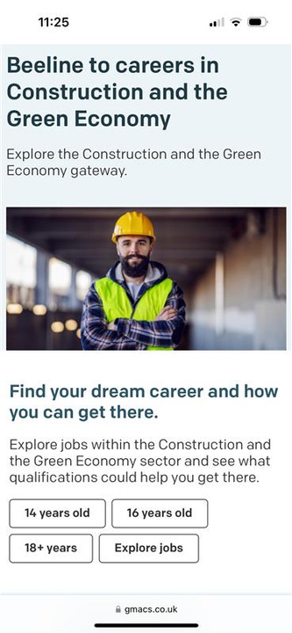

Beeline
Beeline is a digital tool on the GMACS website that allows you to explore real jobs in the MBacc gateways and signposts you to the qualifications most valued by Greater Manchester employers.
High quality jobs await .
Beeline puts you on the path to them.
Visit gmacs.co.uk/beeline

Slide 5




Follow us!
@yourgmacs
@YourGMACS
@GMACS-GM

